Slide 1
Synthesis, structure (using IR results) and reactions of π-acid complexes: Carbonyl compounds
Dr Semanti Basu
Assistant Professor
Department of Chemistry
Bejoy Narayan Mahavidyalaya,
Itachuna, Hooghly, W. B., India

Slide 2
Metal carbonyls
Coordination number around the metal normally remains six or lesser. 17 electron species such as Mn(CO)_{5,} Co(CO)₄ dimerize to gain 18 electrons
V(CO)₆ does not dimerize.

Slide 3
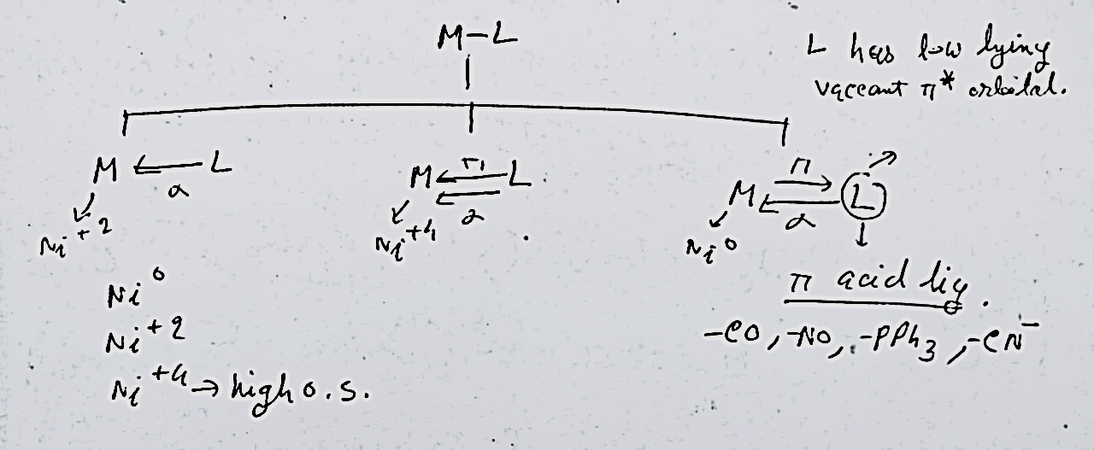

Slide 4
Why study metal carbonyls ?
Simplest of organometallic compounds where M-C σ bonding is well understood. CO is one of the strongest π acceptor ligands. Back bonding (π bonding) and variation in electronic properties of CO can be monitored very efficiently by Infrared spectroscopy
A range of metal carbonyls are used as catalysts in Chemical Industry
Hydroformylation
Alkene to Aldehyde
Methanol to Acetic acid Process

Slide 5
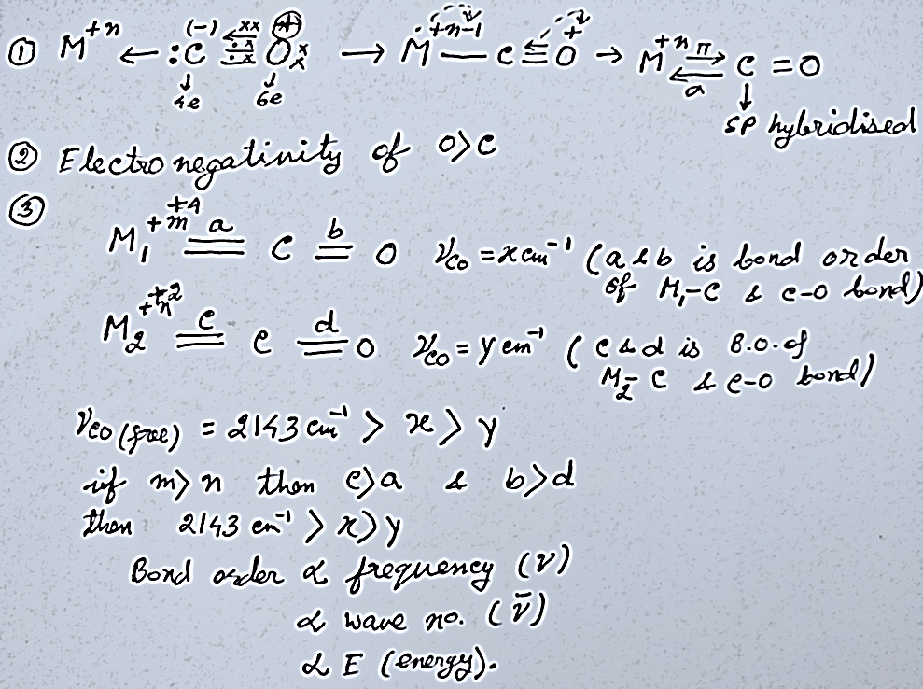

$π$-acceptor properties of CO, synergic effect
[Ni(CO)4], Ni(0)=d(10); Ƴco = x cm-1
[Co(CO)4]-, Co(-1)=d(10); Ƴco = y cm-1
Free Ƴco = y cm-1
Z > X > Y
More back bonding = More increase of the M-C bond order = More lowering of the C=O bond order = More lower ν _{CO} stretching frequency. ΔE = E₂ – E₁ = hΔν = $\frac{hc}{Δλ}$ = hcΔ$\overline{ν}$, So E$∝\overline{ν}$ (in cm⁻¹)

Slide 6
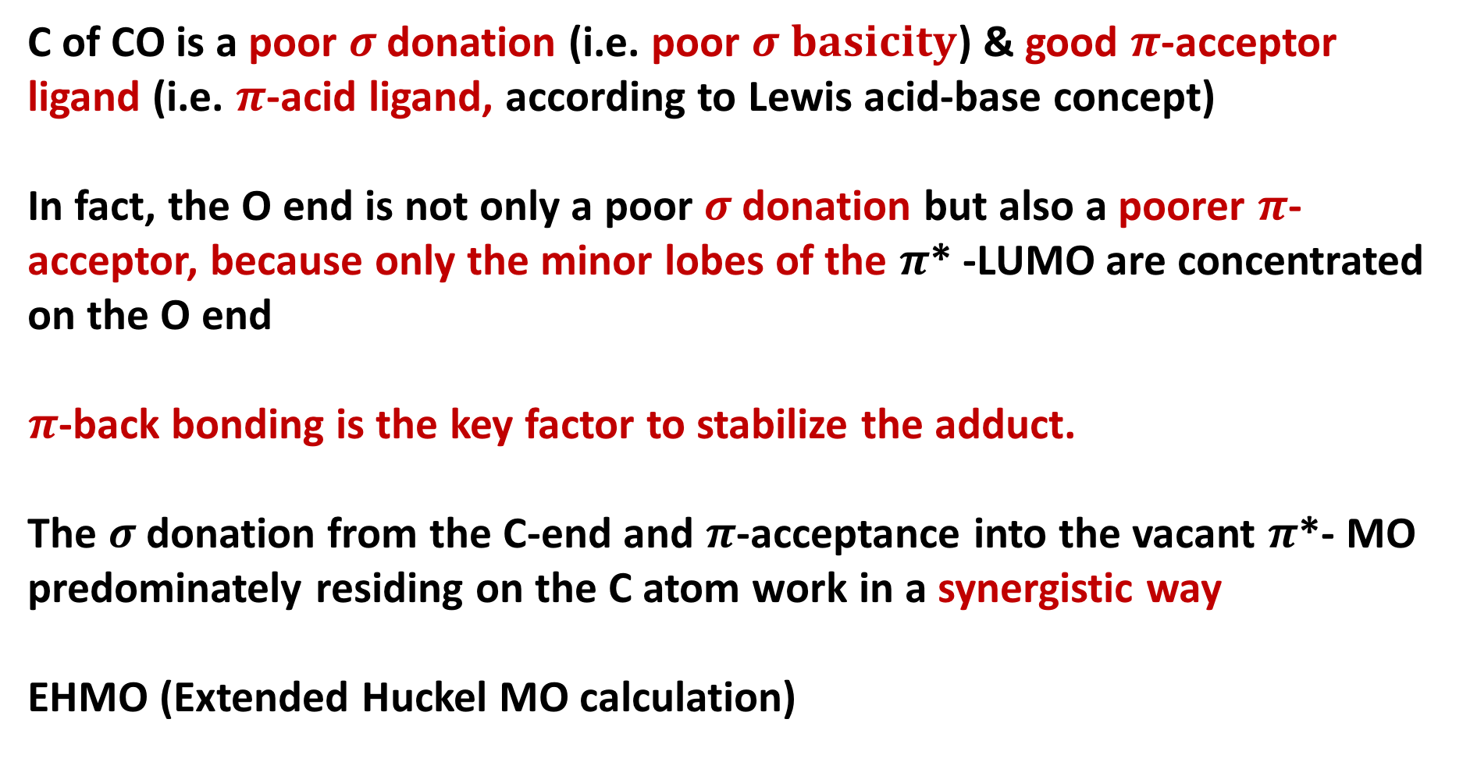
$π$-acceptor properties of CO, synergic effect
C of CO is a poor $σ$donation (i.e. poor $σ basicity$) &good $π$-acceptor ligand (i.e. $π$-acid ligand, according to Lewis acid-base concept)
In fact, the O end is not only a poor $σ$donation but also a poorer $π$-acceptor, because only the minor lobes of the $π$* -LUMO are concentrated on the O end
$π$-back bonding is the key factor to stabilize the adduct.
The $σ$donation from the C-end and $π$-acceptance into the vacant $π$*- MO predominately residing on the C atom work in a synergistic way
EHMO (Extended Huckel MO calculation)

Slide 7
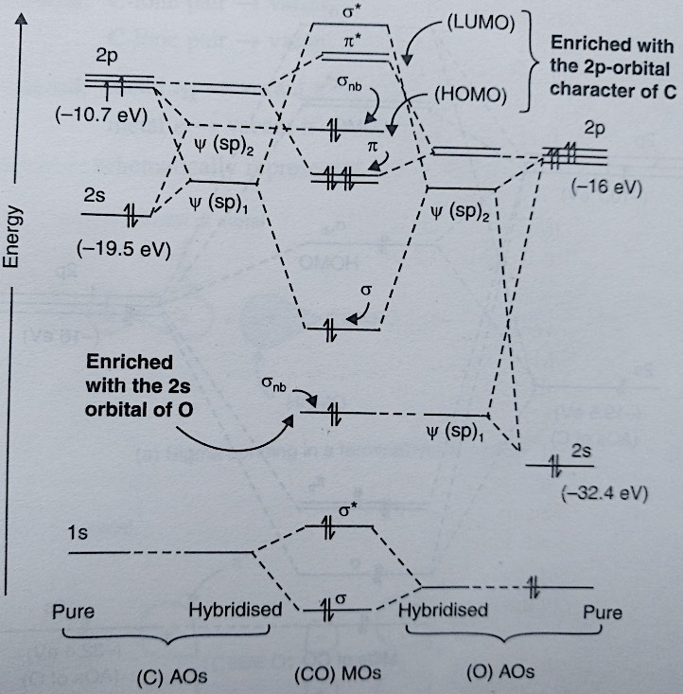
MO energy level diagram of CO
EHMO (Extended
Huckel MO calculation)

Slide 8
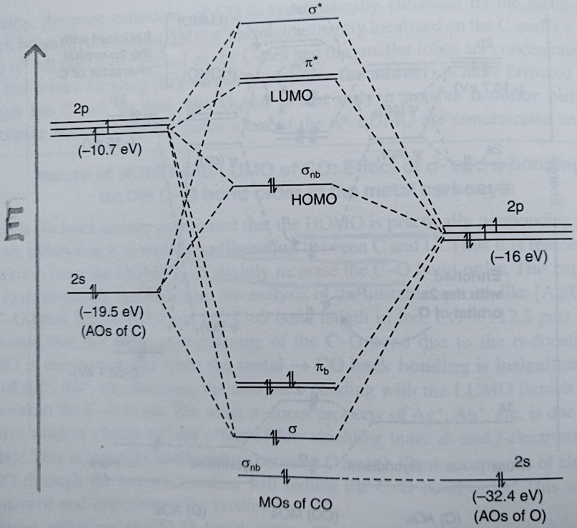
MO energy level diagram of CO

Slide 9
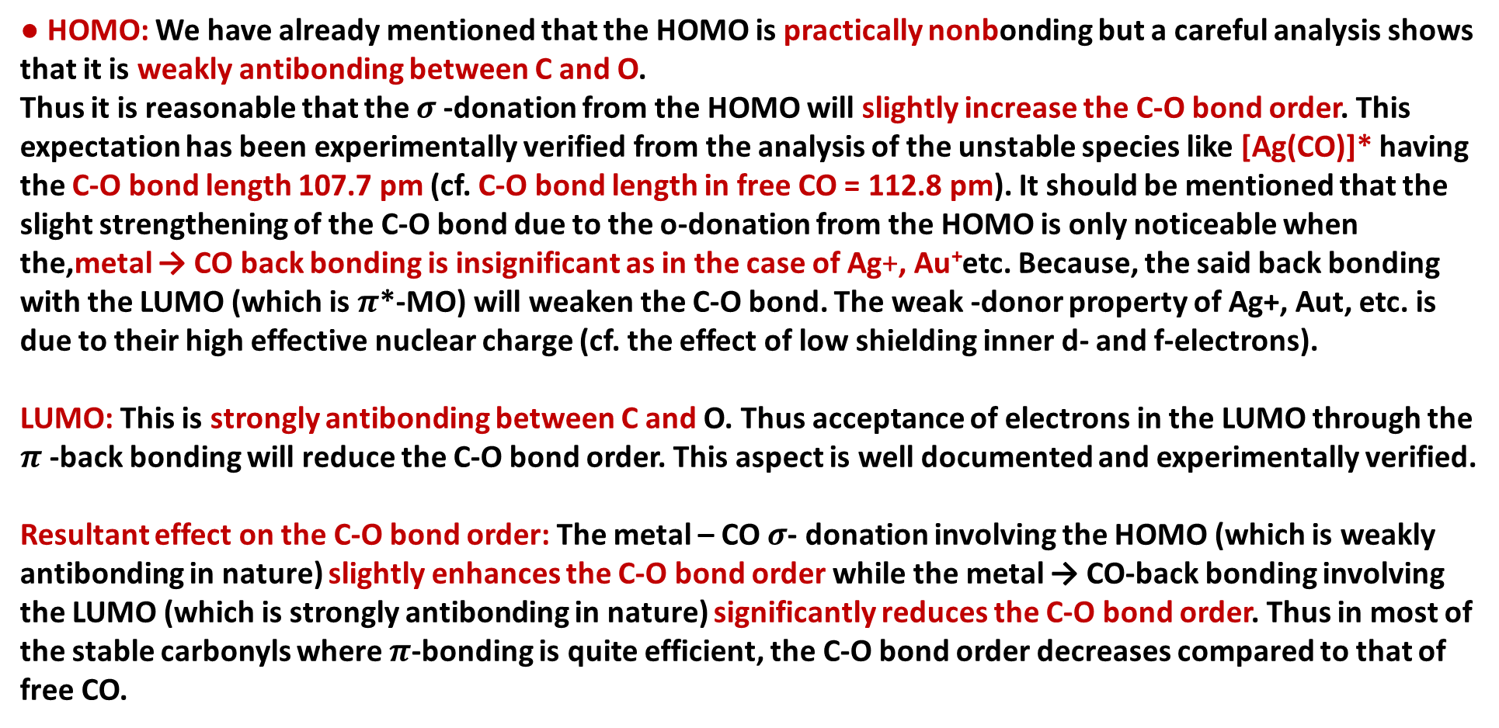
Nature of HOMO and LUMO of CO: Effect of $σ$- and $π$-bonding on the C-O bond order in the metal carbonyls
● HOMO: We have already mentioned that the HOMO is practically nonbonding but a careful analysis shows that it is weakly antibonding between C and O.
Thus it is reasonable that the $σ$-donation from the HOMO will slightly increase the C-O bond order. This expectation has been experimentally verified from the analysis of the unstable species like [Ag(CO)]* having the C-O bond length 107.7 pm (cf. C-O bond length in free CO = 112.8 pm). It should be mentioned that the slight strengthening of the C-O bond due to the o-donation from the HOMO is only noticeable when the,metal → CO back bonding is insignificant as in the case of Ag+, Au⁺etc. Because, the said back bonding with the LUMO (which is $π$*-MO) will weaken the C-O bond. The weak -donor property of Ag+, Aut, etc. is due to their high effective nuclear charge (cf. the effect of low shielding inner d- and f-electrons).
LUMO: This is strongly antibonding between C and O. Thus acceptance of electrons in the LUMO through the $π$-back bonding will reduce the C-O bond order. This aspect is well documented and experimentally verified.
Resultant effect on the C-O bond order: The metal – CO $σ$- donation involving the HOMO (which is weakly antibonding in nature) slightly enhances the C-O bond order while the metal → CO-back bonding involving the LUMO (which is strongly antibonding in nature) significantly reduces the C-O bond order. Thus in most of the stable carbonyls where $π$-bonding is quite efficient, the C-O bond order decreases compared to that of free CO.

Slide 10
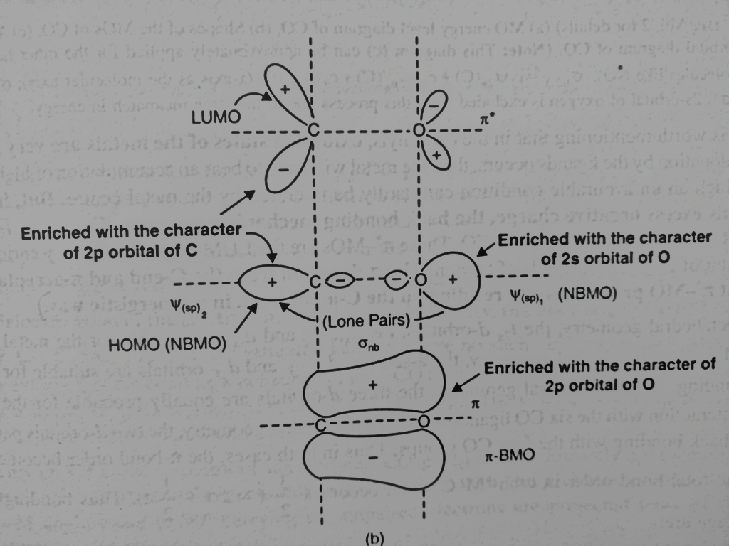
MO energy level diagram of CO

Slide 11
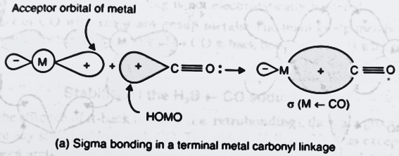
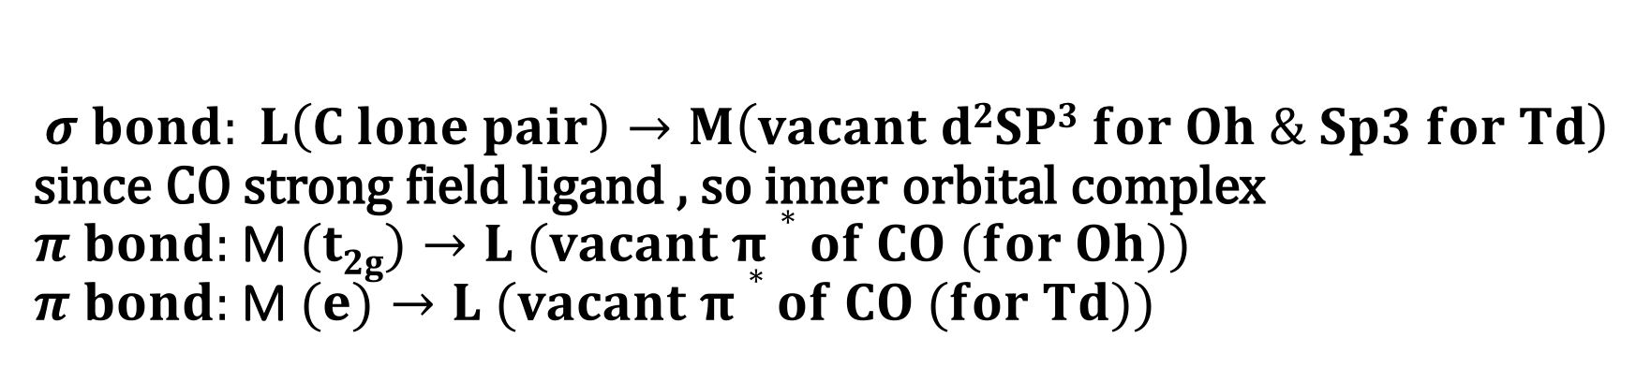
$$σ bond: L\left(C lone pair\right)→M\left(vacant d2SP3 for Oh \& Sp3 for Td\right)$$ since CO strong field ligand , so inner orbital complex
$π bond:$M$(t2g)→L (vacant π∗of CO (for Oh))$
$π bond:$M$(e)→L (vacant π∗of CO (for Td))$
Schematic representation of synergistic $σ$bonding in terminal M-CO bond

Slide 12
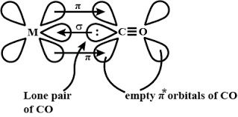
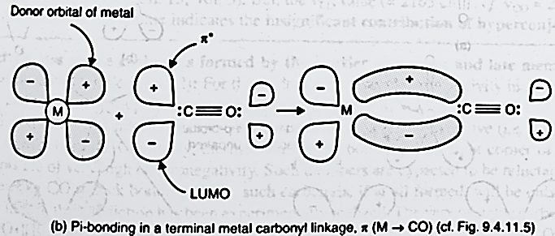
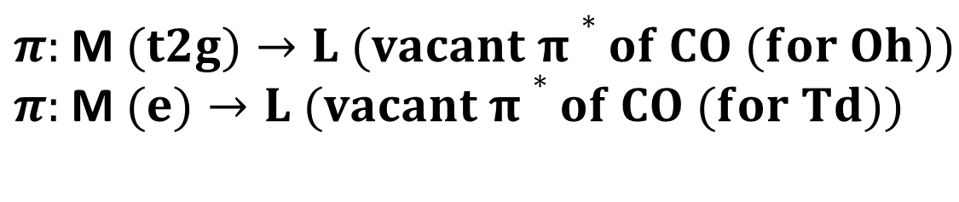
Schematic representation of synergistic $π$ bonding in terminal M-CO bond
$π:$M$(t2g)→L (vacant π∗of CO (for Oh))$
$π:$M$(e)→L (vacant π∗of CO (for Td))$

Slide 13
Use of IR data to explain extent of back bonding
Characterization of Organometallic compounds
X-ray crystallography
Infrared spectroscopy
NMR spectroscopy
Mass spectrometry
Elemental analysis
Others

Slide 14
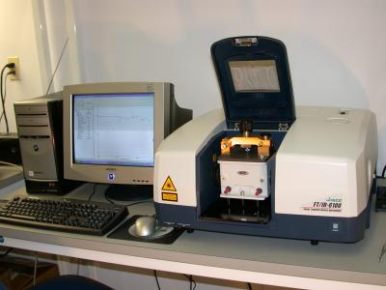
Infrared Spectroscopy- A spectro-analytical tool in chemistry
Infrared (IR) spectroscopy is one of the most common spectroscopic techniques used by organic and inorganic chemists. Simply, it is the absorption measurement of different IR frequencies by a compound positioned in the path of an IR beam. The main goal of IR spectroscopic analysis is to determine the chemical functional groups in the sample. Functional groups are identified based on vibrational modes of the groups such a stretching, bending etc. Different vibrational modes absorb characteristic frequencies of IR radiation. An infrared spectrophotometer is an instrument that passes infrared light through a molecule and produces a spectrum that contains a plot of the amount of light transmitted on the vertical axis against the wave number (in Cm⁻¹) of infrared radiation on the horizontal axis. Absorption of radiation lowers the percentage transmittance value.

Slide 15
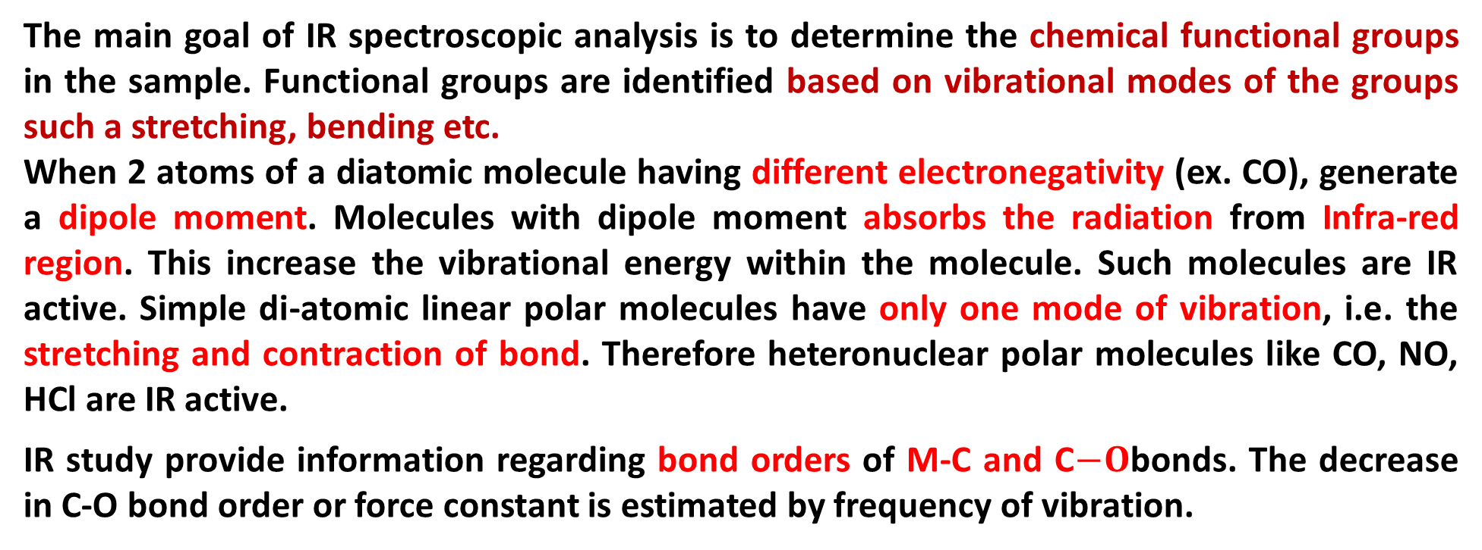
Infrared Spectroscopy- A spectro-analytical tool in chemistry
The main goal of IR spectroscopic analysis is to determine the chemical functional groups in the sample. Functional groups are identified based on vibrational modes of the groups such a stretching, bending etc.
When 2 atoms of a diatomic molecule having different electronegativity (ex. CO), generate a dipole moment. Molecules with dipole moment absorbs the radiation from Infra-red region. This increase the vibrational energy within the molecule. Such molecules are IR active. Simple di-atomic linear polar molecules have only one mode of vibration, i.e. the stretching and contraction of bond. Therefore heteronuclear polar molecules like CO, NO, HCl are IR active.
IR study provide information regarding bond orders of M-C and C$−O$bonds. The decrease in C-O bond order or force constant is estimated by frequency of vibration.

Slide 16
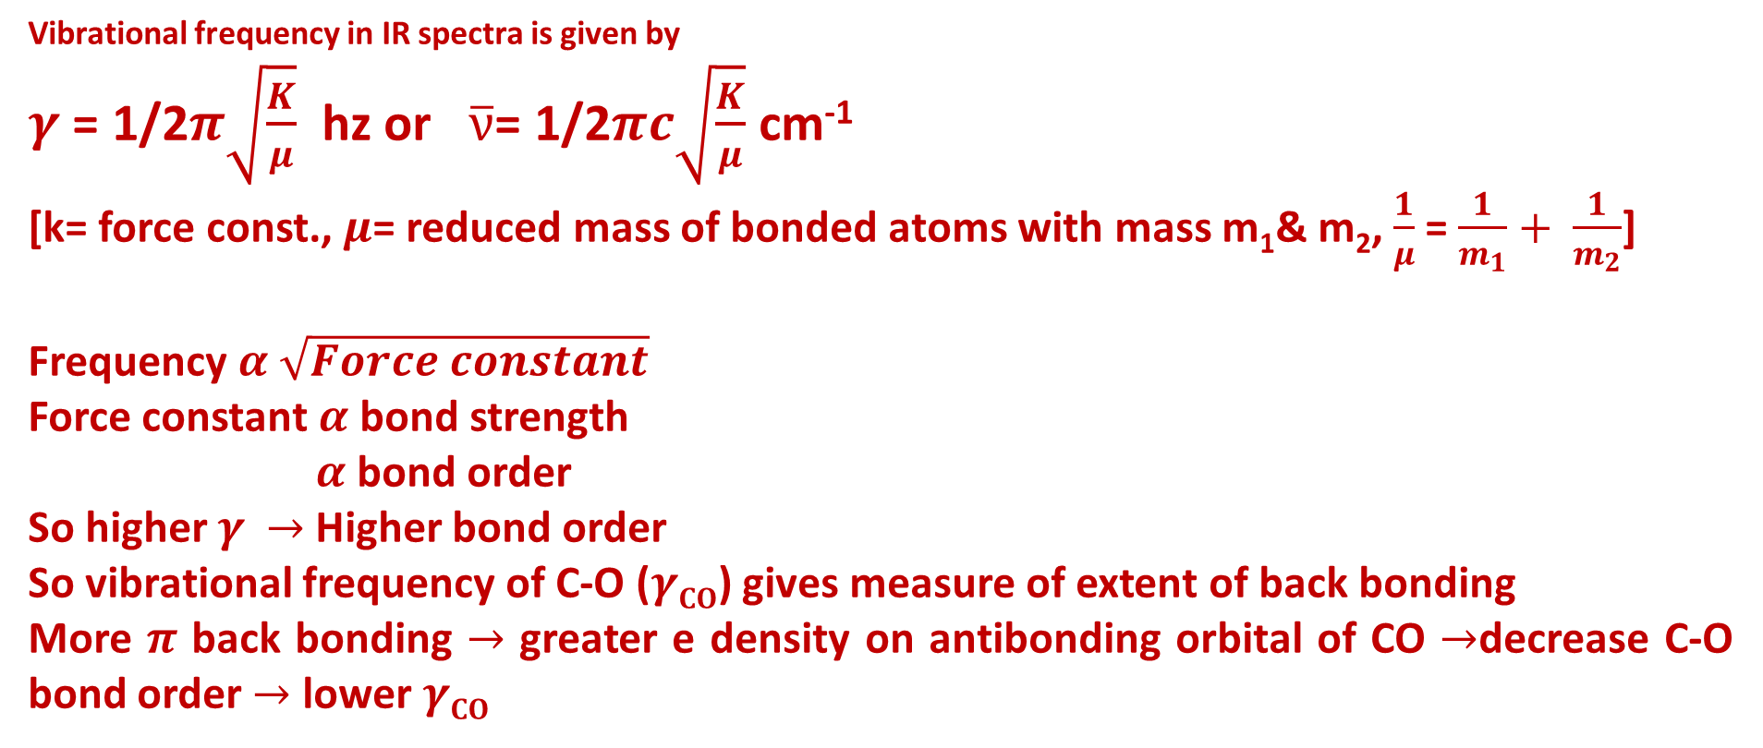
Vibrational frequency in IR spectra is given by
$γ$ = 1/2$π\sqrt{\frac{K}{μ}}$ hz or $\overline{ν}$= 1/2$πc\sqrt{\frac{K}{μ}}$ cm⁻¹
[k= force const., $μ$= reduced mass of bonded atoms with mass m₁& m₂, $\frac{1}{μ}$ = $\frac{1}{m_{1}}+ \frac{1}{m_{2}}$]
Frequency $α$ $\sqrt{Force constant}$
Force constant $α$ bond strength
$α$ bond order
So higher $γ$ $→$ Higher bond order
So vibrational frequency of C-O ($γCO$) gives measure of extent of back bonding
More $π$ back bonding $→$ greater e density on antibonding orbital of CO $→$decrease C-O bond order $→$ lower $γCO$

Slide 17
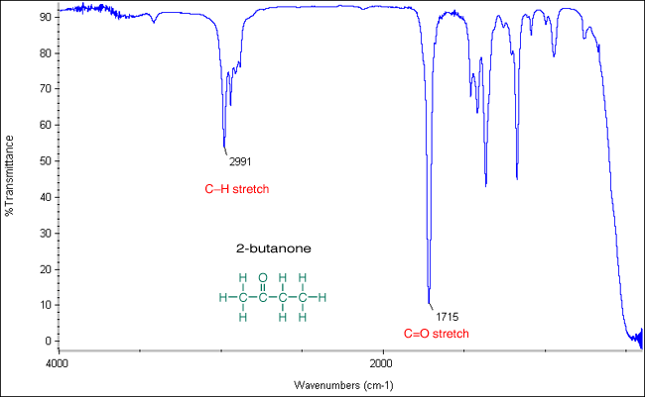
Infrared Spectroscopy- A spectro-analytical tool in chemistry

Slide 18
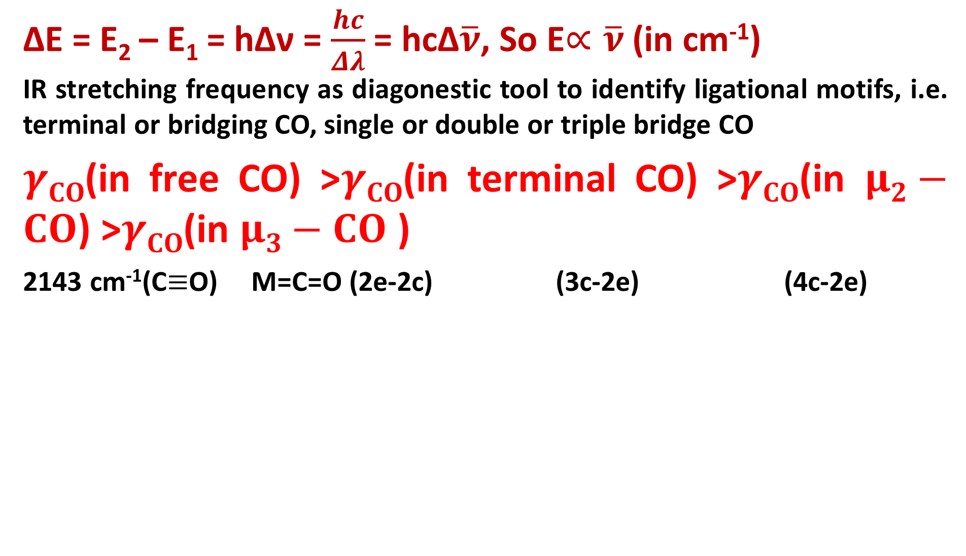
Infrared Spectroscopy- A spectro-analytical tool in chemistry
ΔE = E₂ – E₁ = hΔν = $\frac{hc}{Δλ}$ = hcΔ$\overline{ν}$, So E$∝\overline{ν}$ (in cm⁻¹)
IR stretching frequency as diagonestic tool to identify ligational motifs, i.e. terminal or bridging CO, single or double or triple bridge CO
$γCO$(in free CO) >$γCO$(in terminal CO) >$γCO$(in $μ2−CO$) >$γCO$(in $μ3−CO$ )
2143 cm⁻¹(C$≡$O) M=C=O (2e-2c) (3c-2e) (4c-2e)

Slide 19
Terminal versus bridging carbonyls
2000 cm-1
2018, 1826 cm-1
1620 cm-1

Slide 20
Infrared Spectroscopy- Spectra of Metal Carbonyls
The range in which the band appears decides bridging or terminal .
The number of bands is only related to the symmetry of the molecule
^{terminal}
bridging
^{terminal}

Slide 21
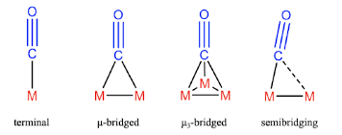
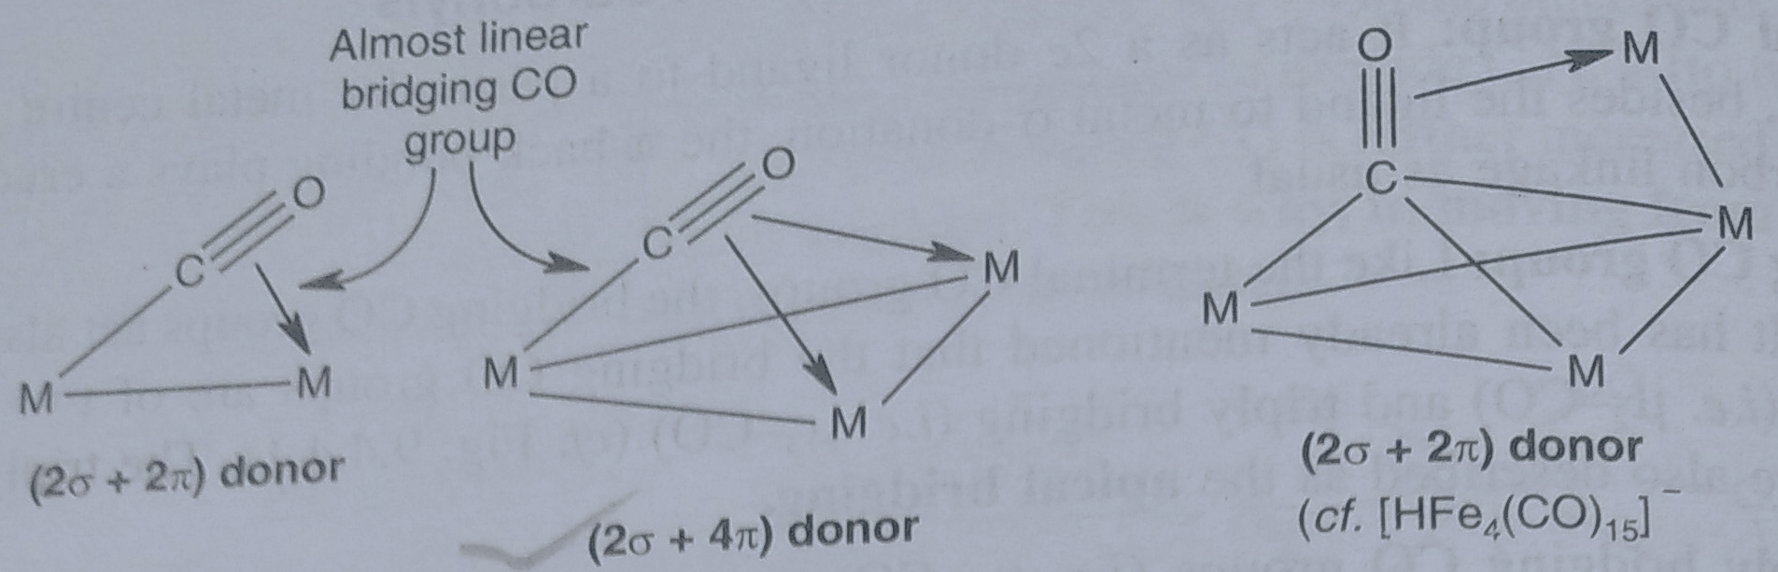
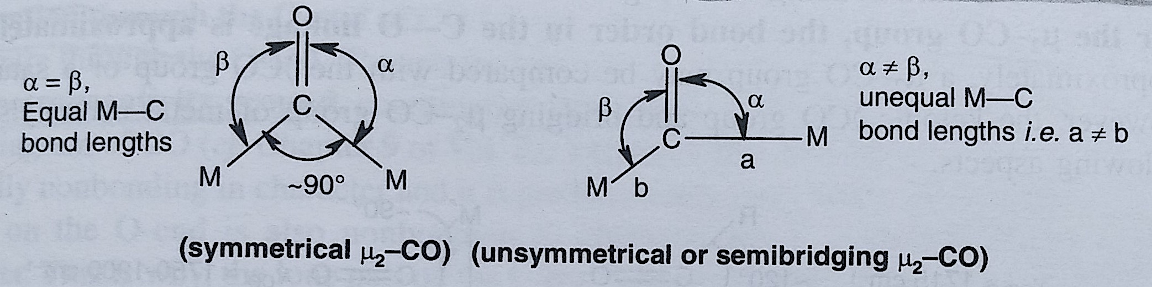
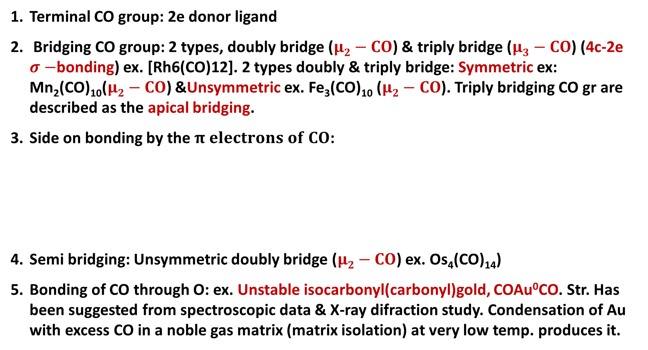
Coordinating Behaviours of the CO group in Carbonyls
Terminal CO group: 2e donor ligand
Bridging CO group: 2 types, doubly bridge ($μ2−CO$) & triply bridge ($μ3−CO$) (4c-2e $σ−$bonding) ex. [Rh6(CO)12]. 2 types doubly & triply bridge: Symmetric ex: Mn₂(CO)₁₀($μ2−CO$) &Unsymmetric ex. Fe₃(CO)₁₀ ($μ2−CO$). Triply bridging CO gr are described as the apical bridging.
Side on bonding by the $π electrons of CO$:
Semi bridging: Unsymmetric doubly bridge ($μ2−CO$) ex. Os₄(CO)₁₄)
Bonding of CO through O: ex. Unstable isocarbonyl(carbonyl)gold, COAu⁰CO. Str. Has been suggested from spectroscopic data & X-ray difraction study. Condensation of Au with excess CO in a noble gas matrix (matrix isolation) at very low temp. produces it.

Slide 22
Coordinating Behaviours of the CO group in Carbonyls

Slide 23
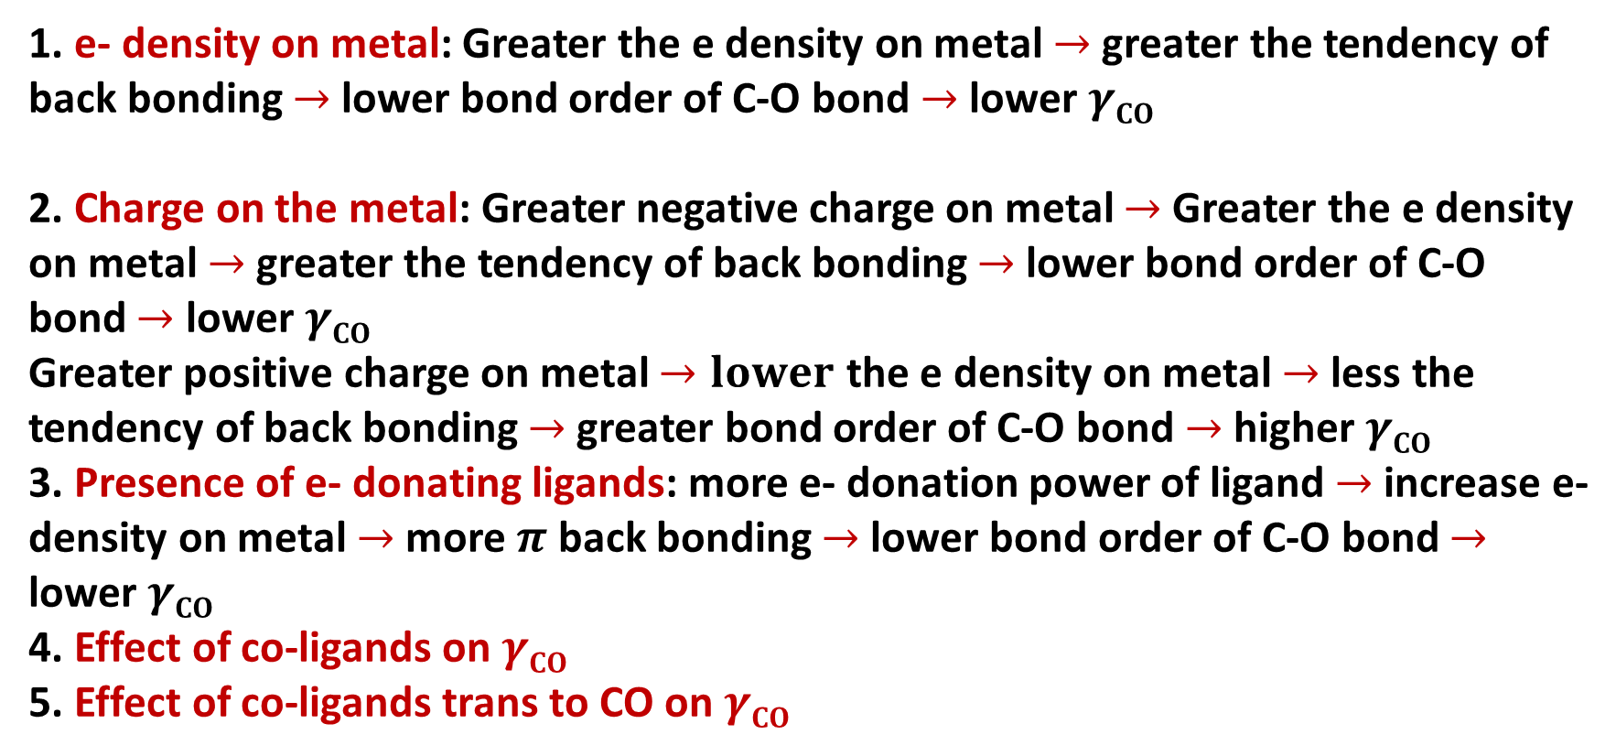
Factors which affect ν_{CO} stretching frequencies
1. e- density on metal: Greater the e density on metal $→$ greater the tendency of back bonding $→$ lower bond order of C-O bond $→$ lower $γCO$
2. Charge on the metal: Greater negative charge on metal $→$Greater the e density on metal $→$ greater the tendency of back bonding $→$ lower bond order of C-O bond $→$ lower $γCO$
Greater positive charge on metal $→lower$ the e density on metal $→$ less the tendency of back bonding $→$ greater bond order of C-O bond $→$ higher $γCO$
3. Presence of e- donating ligands: more e- donation power of ligand $→$ increase e- density on metal $→$ more $π$ back bonding $→$ lower bond order of C-O bond $→$ lower $γCO$
4. Effect of co-ligands on $γCO$
5. Effect of co-ligands trans to CO on $γCO$

Slide 24
Factors which affect ν_{CO} stretching frequencies
1.Charge on the metal
Variation in ν_{CO} (cm^{–1}) of the first row transition metal carbonyls
 | free CO: 2143
Ni(CO)₄: 2057
Co(CO)₄⁻ : 1890 |  | Co₂(CO)₈ :2044(av, ter)
[Fe(CO)₄]²⁻: 1815 |  | Fe(CO)₅: 2030
[Mn(CO)₄]³⁻1600,1790 | Mn(CO)₆ + 2098 | Mn₂(CO)₁₀ 2013 (av)
[Cr(CO)₄]⁴⁻ 1462,1657 | Cr(CO)₆ 2000
 | V(CO)₆¯: 1860 | V(CO)₆: 1976
 | Ti(CO)₆²⁻ : 1747
As the electron density on a metal centre increases, more π-back­bonding to the CO ligand(s) takes place. This weakens the C–O bond further as more electron density is pumped into the empty π* anti-bonding carbonyl orbital. This increases the M–C bond order and reduces the
C-O bond order. That is, the resonance structure M=C=O becomes more dominant.
More back bonding

Slide 25

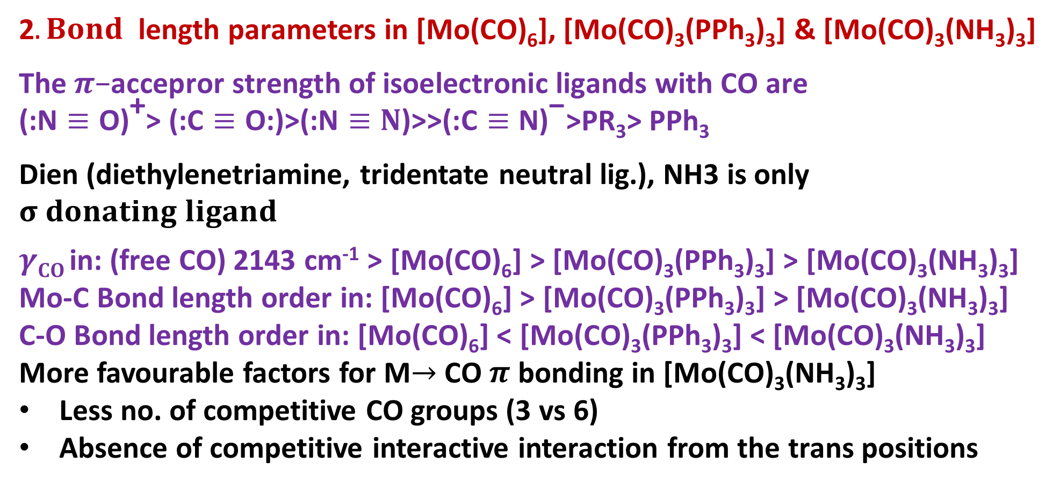
2. Effect of co-ligands on $γCO$
2$. Bond$ length parameters in [Mo(CO)₆], [Mo(CO)₃(PPh₃)₃] &[Mo(CO)₃(NH₃)₃]
$$\text{The} π\text{−}\text{accepror} \text{strength} \text{of} \text{isoelectronic} \text{ligands} \text{with} \text{CO} \text{are}$$
$\text{(:}\text{N}≡\text{O}\text{)}\text{+}\text{> (:}\text{C}≡\text{O}\text{:)>(:}\text{N}≡N\text{)>>(:}\text{C}≡\text{N}\text{)}\text{−}$>PR₃> PPh₃
Dien (diethylenetriamine, tridentate neutral lig.), NH3 is only $σ donating ligand$
$γCO$in: (free CO) 2143 cm⁻¹> [Mo(CO)₆] > [Mo(CO)₃(PPh₃)₃] > [Mo(CO)₃(NH₃)₃] Mo-C Bond length order in: [Mo(CO)₆] > [Mo(CO)₃(PPh₃)₃] > [Mo(CO)₃(NH₃)₃]
C-O Bond length order in: [Mo(CO)₆] <[Mo(CO)₃(PPh₃)₃] <[Mo(CO)₃(NH₃)₃]
More favourable factors for M$→$ CO $π$ bonding in [Mo(CO)₃(NH₃)₃]
Less no. of competitive CO groups (3 vs 6)
Absence of competitive interactive interaction from the trans positions

Slide 26

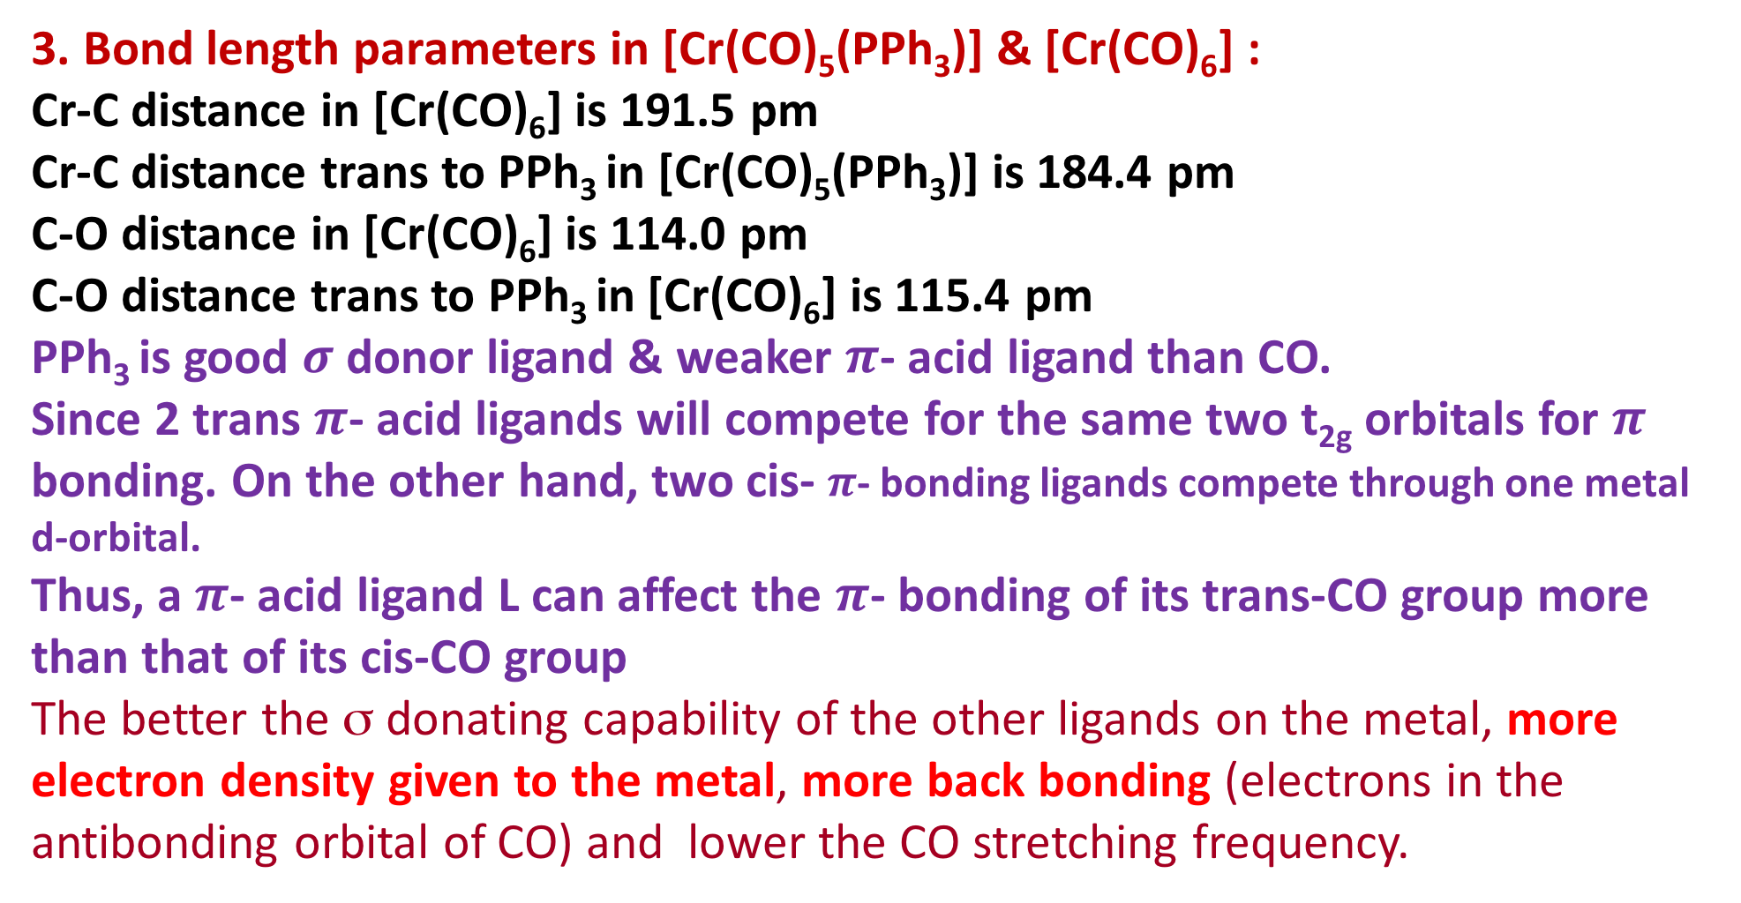
3. Effect of co-ligands trans to CO on $γCO$
3. Bond length parameters in [Cr(CO)₅(PPh₃)] &[Cr(CO)₆] :
Cr-C distance in [Cr(CO)₆] is 191.5 pm
Cr-C distance trans to PPh₃ in [Cr(CO)₅(PPh₃)] is 184.4 pm
C-O distance in [Cr(CO)₆] is 114.0 pm
C-O distance trans to PPh₃ in [Cr(CO)₆] is 115.4 pm
PPh₃ is good $σ$ donor ligand & weaker $π$- acid ligand than CO.
Since 2 trans $π$- acid ligands will compete for the same two t_{2g} orbitals for $π$ bonding. On the other hand, two cis-$π$- bonding ligands compete through one metal d-orbital.
Thus, a $π$- acid ligand L can affect the $π$- bonding of its trans-CO group more than that of its cis-CO group
The better the σ donating capability of the other ligands on the metal, more electron density given to the metal, more back bonding (electrons in the antibonding orbital of CO) and lower the CO stretching frequency.

Slide 27
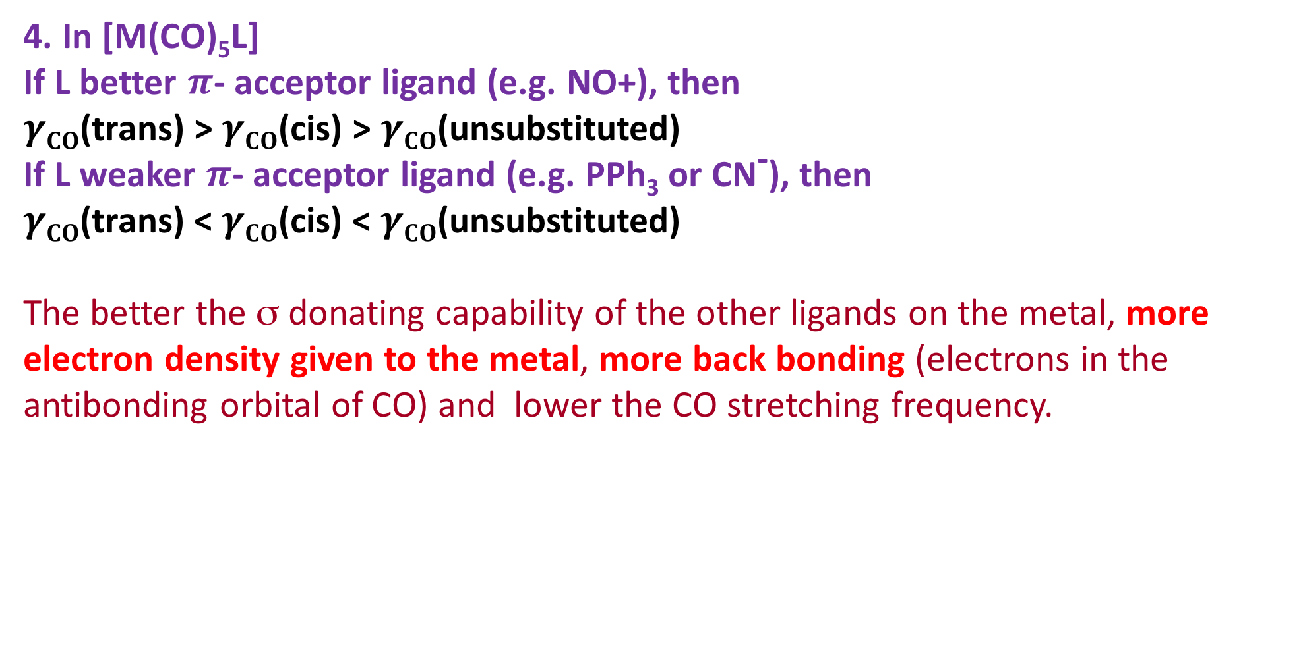
3. Effect of co-ligands trans to CO on $γCO$
4. In [M(CO)₅L]
If L better $π$- acceptor ligand (e.g. NO+), then
$γCO$(trans) > $γCO$(cis) > $γCO$(unsubstituted)
If L weaker $π$- acceptor ligand (e.g. PPh₃ or CN⁻), then
$γCO$(trans) < $γCO$(cis) < $γCO$(unsubstituted)
The better the σ donating capability of the other ligands on the metal, more electron density given to the metal, more back bonding (electrons in the antibonding orbital of CO) and lower the CO stretching frequency.

Slide 28
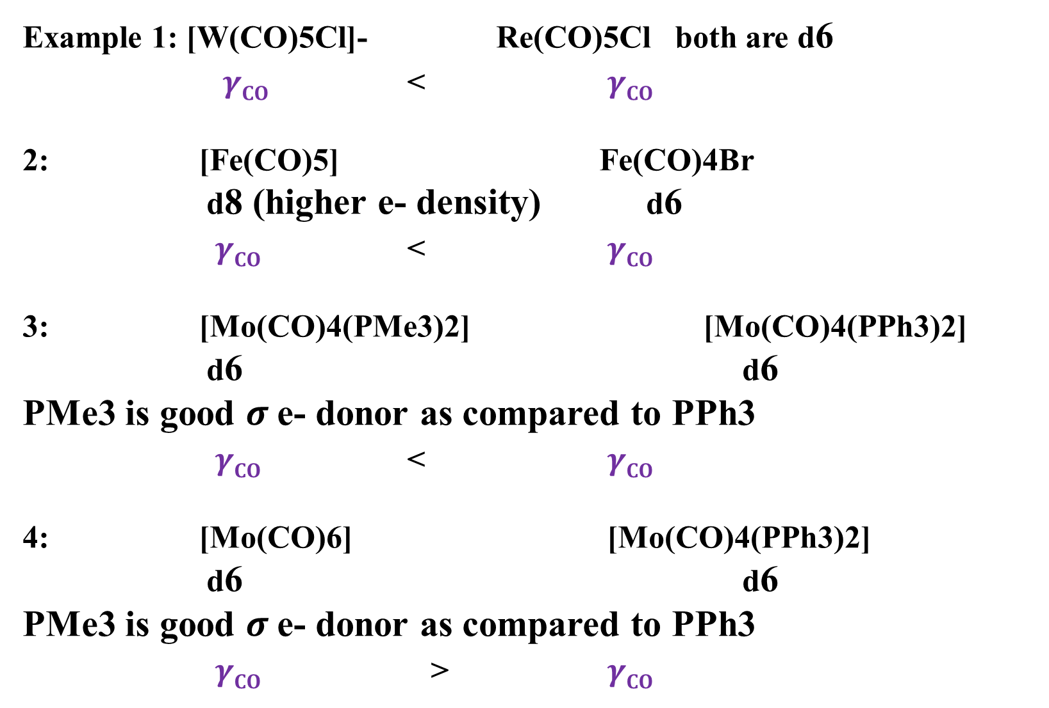
Example 1: [W(CO)5Cl]- Re(CO)5Cl both are d6
$γCO$ < $γCO$
2: [Fe(CO)5] Fe(CO)4Br
d8 (higher e- density) d6
$γCO$ < $γCO$
3: [Mo(CO)4(PMe3)2] [Mo(CO)4(PPh3)2]
d6 d6
PMe3 is good $σ$e- donor as compared to PPh3
$γCO$ < $γCO$
4: [Mo(CO)6] [Mo(CO)4(PPh3)2]
d6 d6
PMe3 is good $σ$e- donor as compared to PPh3
$γCO$ > $γCO$

Slide 29
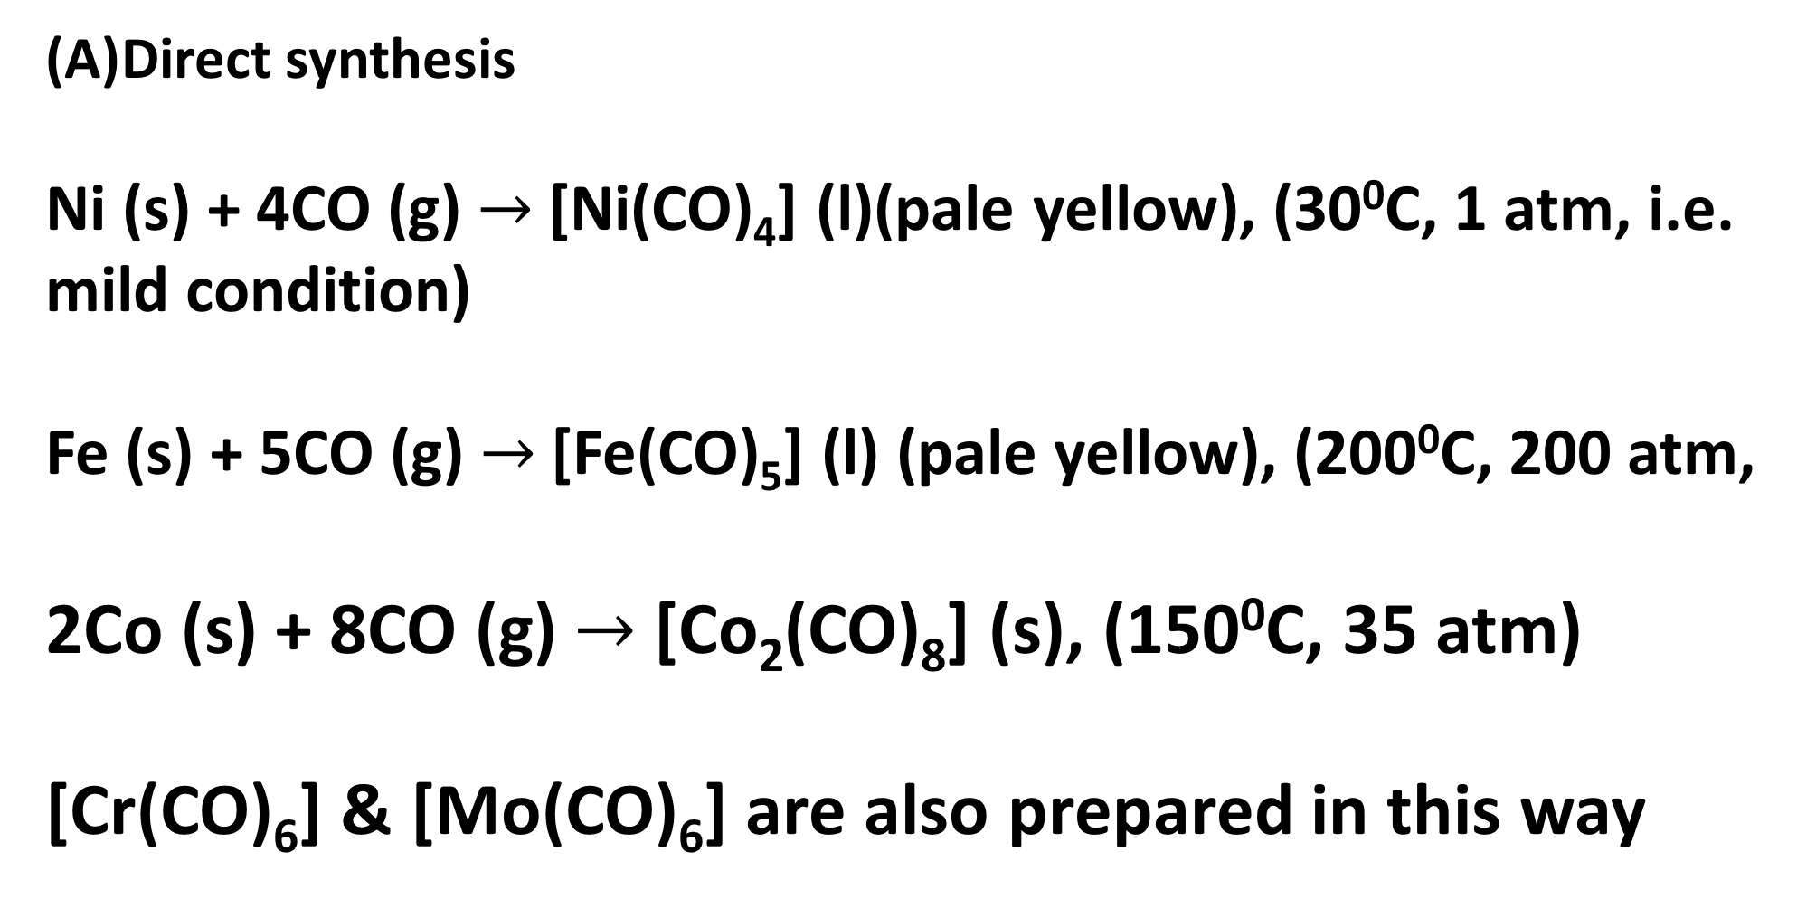
Synthesis of mono-, di- and polynuclear metal carbonyl compounds
Direct synthesis
Ni (s) + 4CO (g)$→$[Ni(CO)₄] (l)(pale yellow), (30⁰C, 1atm, i.e. mild condition)
Fe (s) + 5CO (g)$→$[Fe(CO)₅] (l) (pale yellow),(200⁰C, 200 atm,
2Co (s) + 8CO (g)$→$ [Co₂(CO)₈] (s), (150⁰C, 35 atm)
[Cr(CO)₆] & [Mo(CO)₆] are also prepared in this way

Slide 30
Synthesis of Metal Carbonyls
(B) Reductive carbonylation:
Reduction of metal compounds (generally halides) in presence of CO (generally under at high pressur, 200-300 atm) produces the metal carbonyls.
In some cases, CO may itself act as a reducing agent. This advantage (i.e. no requirement of external reducing agent) is available generally for the metal oxides used as the starting material.
Generally, the temp. & pressure required for the synthesis of carbonyls through the reductive carbonylation are less than those required for the direct combination of CO.

Slide 31
Synthesis of Metal Carbonyls
(B) Reductive carbonylation

Slide 32
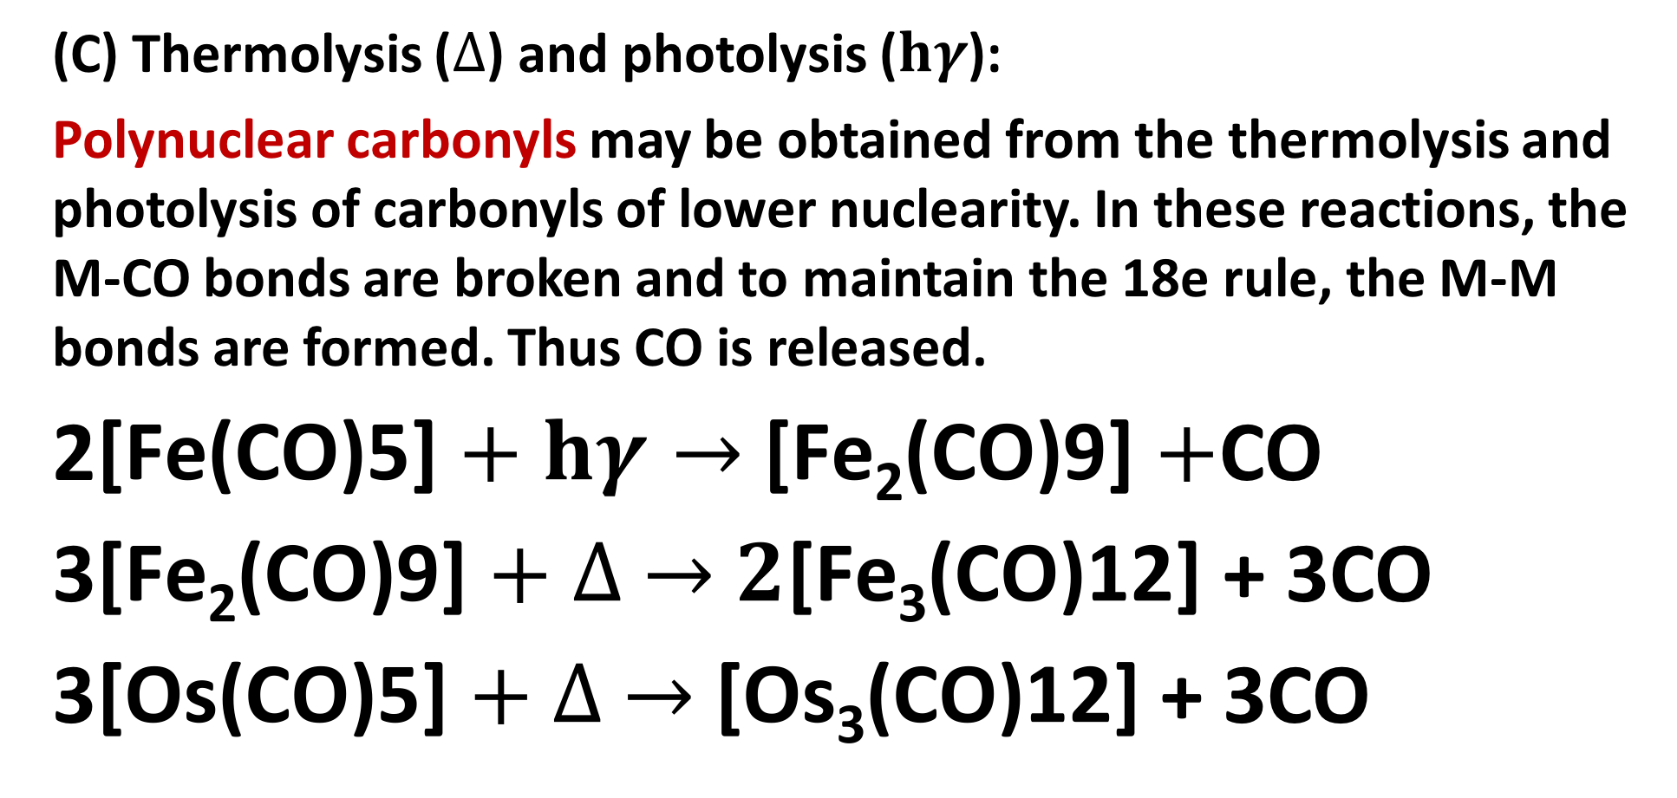
Synthesis of mono-, di- and polynuclear metal carbonyl compounds
(C) Thermolysis ($∆$) and photolysis ($hγ$):
Polynuclear carbonyls may be obtained from the thermolysis and photolysis of carbonyls of lower nuclearity. In these reactions, the M-CO bonds are broken and to maintain the 18e rule, the M-M bonds are formed. Thus CO is released.
2$\text{[}\text{Fe}\text{(}\text{CO}\text{)5]}+hγ→\text{[}\text{Fe}\text{2}\text{(}\text{CO}\text{)9]}+$CO
3$\text{[}\text{Fe}\text{2}\text{(}\text{CO}\text{)9]}+∆ →2\text{[}\text{Fe}\text{3}\text{(}\text{CO}\text{)12]}$ + 3CO
3$\text{[}\text{Os}\text{(}\text{CO}\text{)5]}+∆ →\text{[}\text{Os}\text{3}\text{(}\text{CO}\text{)12]}$ + 3CO

Slide 33
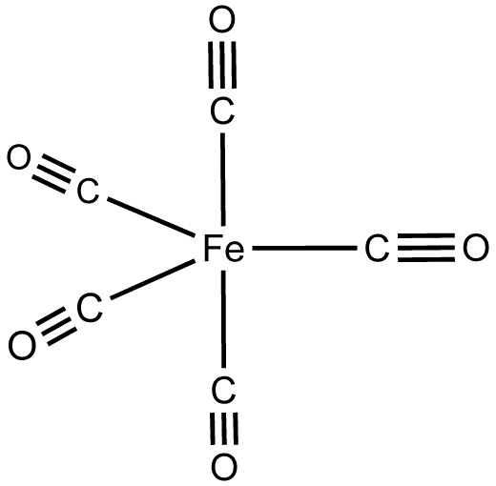
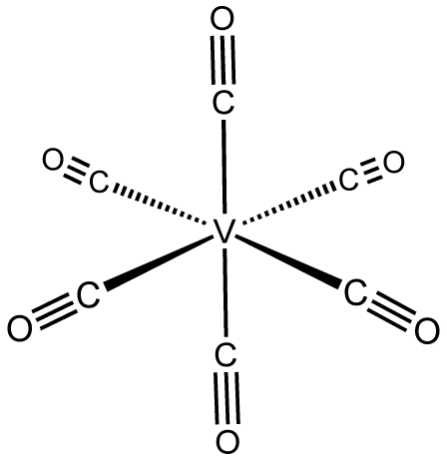
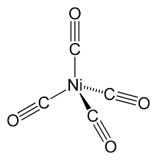
Structures of mononuclear carbonyls
[M(CO)₄]
M is sp³
Tetrahedral
[M(CO)₆], M=Fe, Ru
M is dsp³
TBP
[M(CO)₆], M= V, Cr, W,
Mo, M is d²sp³
Octahedral
In all cases, the inner orbital complexes (since CO is strong field ligand) (i.e. low spin complexes in terms of CFT) are formed by using the (n-1) d orbitals in hybridization. To provide the necessary (n-1) d orbitals (i.e. dx²-y² and dz2 for Oh & dz2 for TBP), the electrons are properly arranged within the inner d-orbitals. It is illustrated in next page

Slide 34
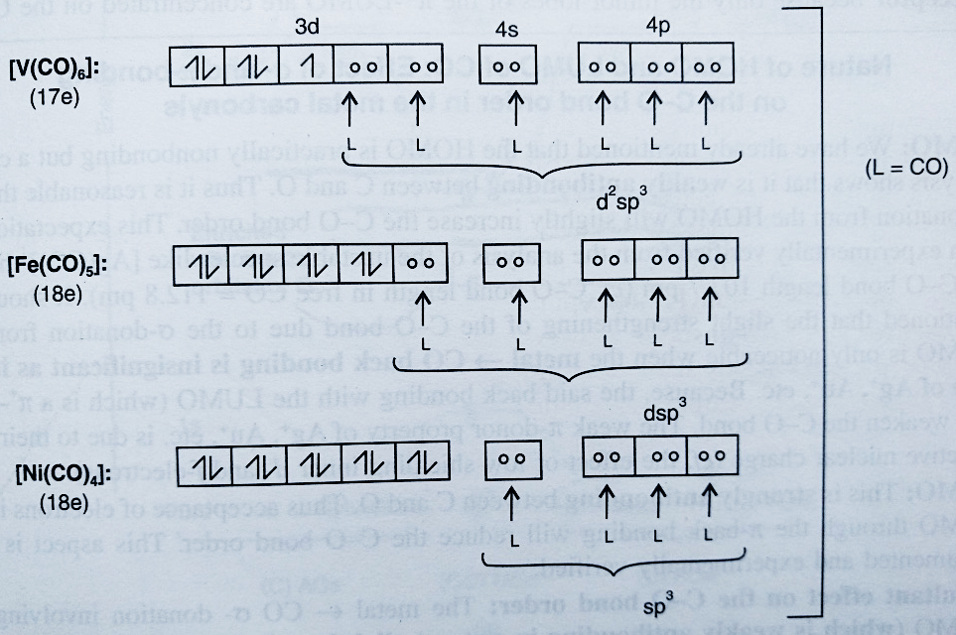
Bonding of mononuclear carbonyls-VBT treatment

Slide 35
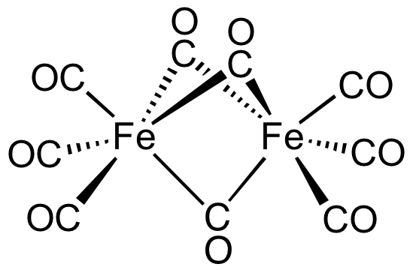

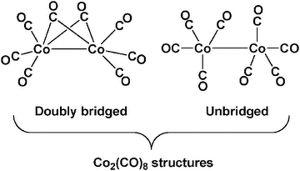
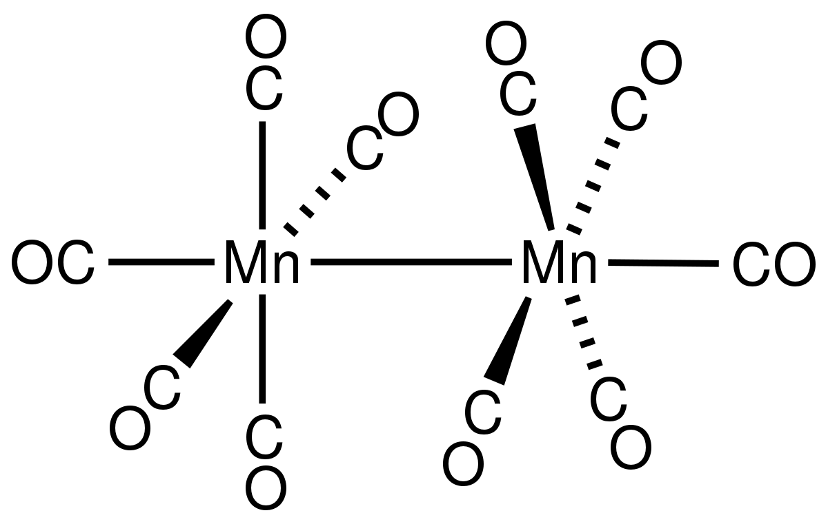
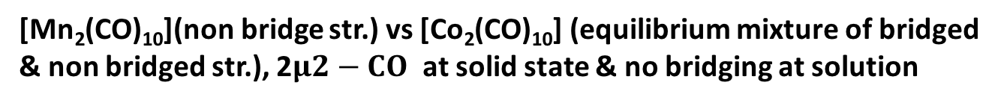
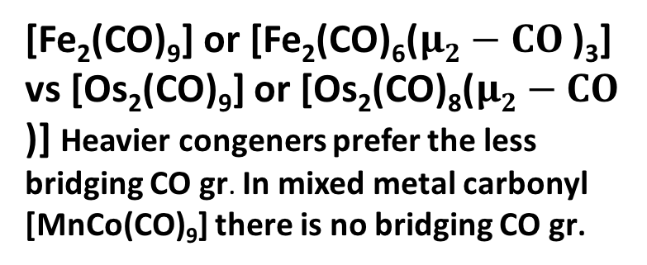
Structures of binuclear carbonyls
[Fe₂(CO)₉] or [Fe₂(CO)₆($μ2−CO$)₃] vs [Os₂(CO)₉] or [Os₂(CO)₈($μ2−CO$)] Heavier congeners prefer the less bridging CO gr. In mixed metal carbonyl [MnCo(CO)₉] there is no bridging CO gr.
[Mn₂(CO)₁₀](non bridge str.) vs [Co₂(CO)₁₀] (equilibrium mixture of bridged
& non bridged str.), 2$μ2−CO$ at solid state & no bridging at solution

Slide 36
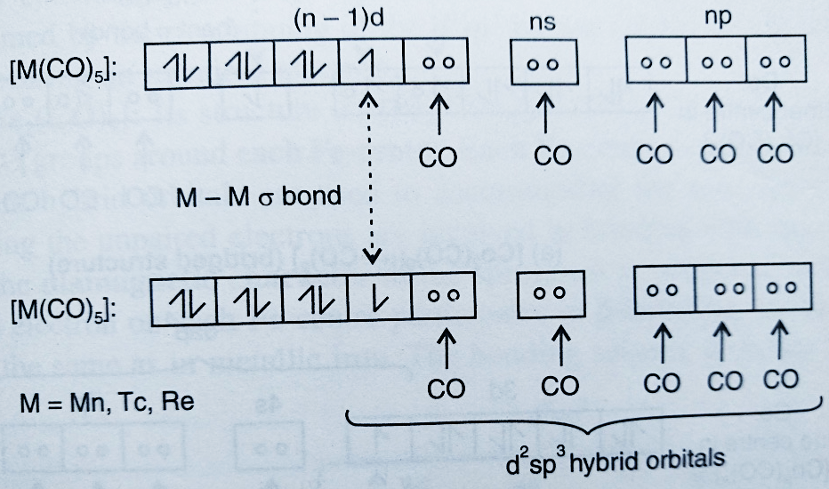
Bonding of di-nuclear carbonyls-VBT treatment

Slide 37
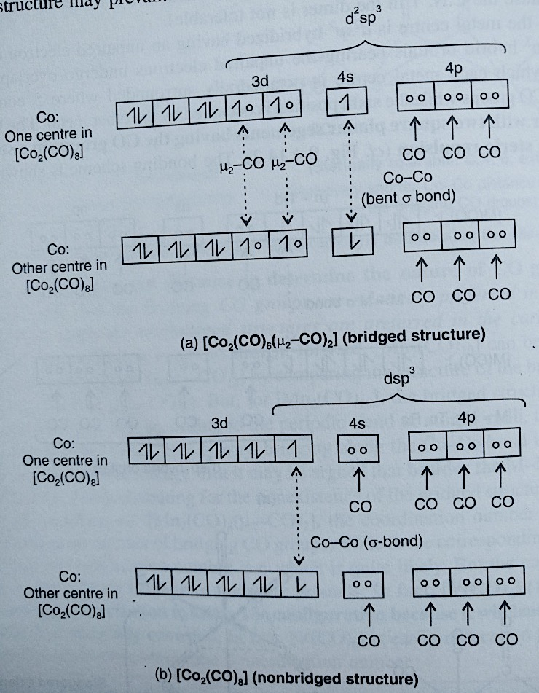
Bonding of di-nuclear carbonyls-VBT treatment

Slide 38
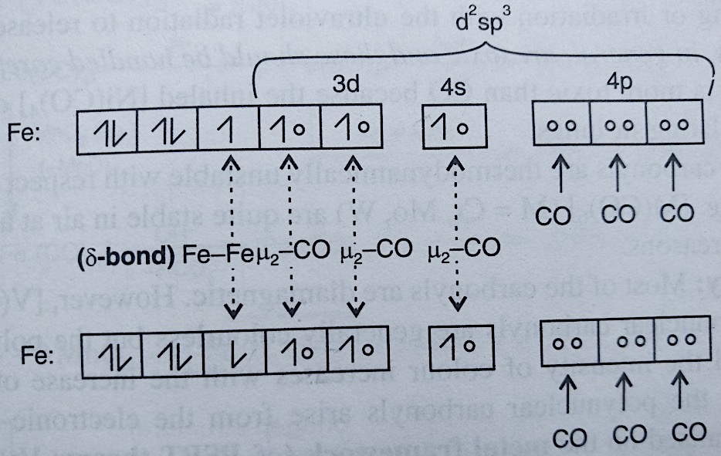
Bonding of di-nuclear carbonyls-VBT treatment

Slide 39
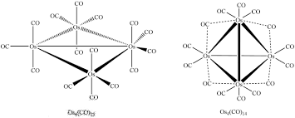
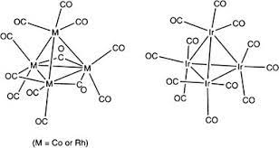
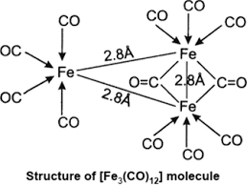
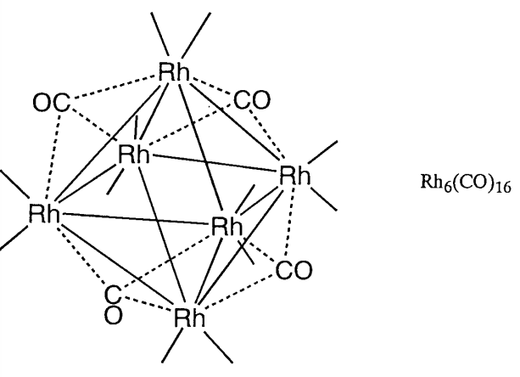
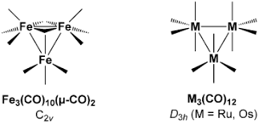
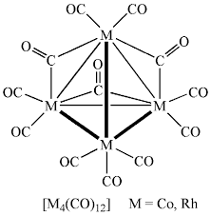
Structures of poly-nuclear carbonyls

Slide 40
Reference
Ashim K Das & Mahua Das, Fundamental Concept of Inorganic Chemistry, CBC Publishers & Distributors, Volume 6, First Edition, 2014
Ashim K Das, Fundamental Concept of Inorganic Chemistry, CBC Publishers & Distributors, Volume 3, Second Edition, 2010
Wahid U. Malik, G. D. Tuli & R. D. Madan, Selected topics in inorganic chemistry, S. Chand & Company Ltd, first edition, 1976
J.E. Huheey, E.A. Keiter, R.L. Keiter, Inorganic Chemistry Principles of Structure and Reactivity, Pearson Education Asia, fourth Edition, 2000

Slide 41
Thank you

